Slide 1
AI for Medicine
Lecture 15:
Logistic Regression- Part I
March 22, 2021
Mohammad Hammoud
Carnegie Mellon University in Qatar

Slide 2
Today…
Last Monday’s Session:
Midterm Exam
Today’s Session:
Logistic Regression- Part I
Announcements:
Midterm exam grades are out
Assignment 2 is due today by midnight

Slide 3
Outline
Logistic Regression
Classification
Hypothesis Function
Cost Function
Gradient Descent

Slide 4
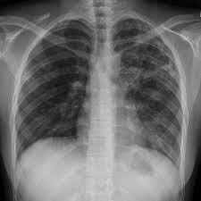
Example 1: Malignant or Benign
Consider the example of recognizing whether a tumor in an input image is malignant or benign
Input:
Output:
Binary Classifier
Benign
0
Can be represented
as integers!
Malignant
1
Can be represented as a matrix of pixels

Slide 5
Example 2: Spam or Not Spam
As another example, consider the problem of detecting whether an email is a spam or not a spam
Input:
Output:
Binary Classifier
Not Spam
0
Can be represented
as integers!
Email
Spam
1
Can be represented as a vector x = [x₁, x₂, . . . , x_{d}], with each component x_{i} corresponding to the presence (x_{i} = 1) or absence (x_{i} = 0) of a particular word (or feature) in the email

Slide 6
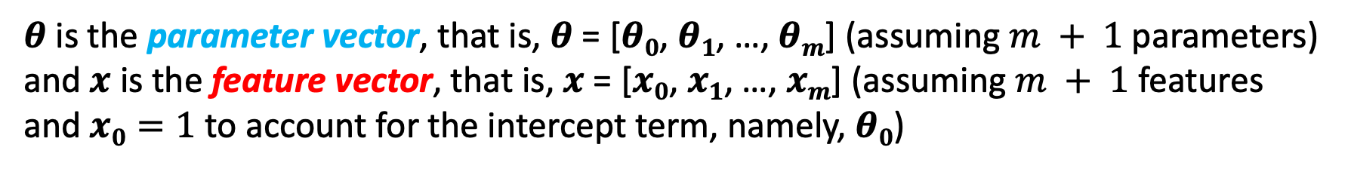
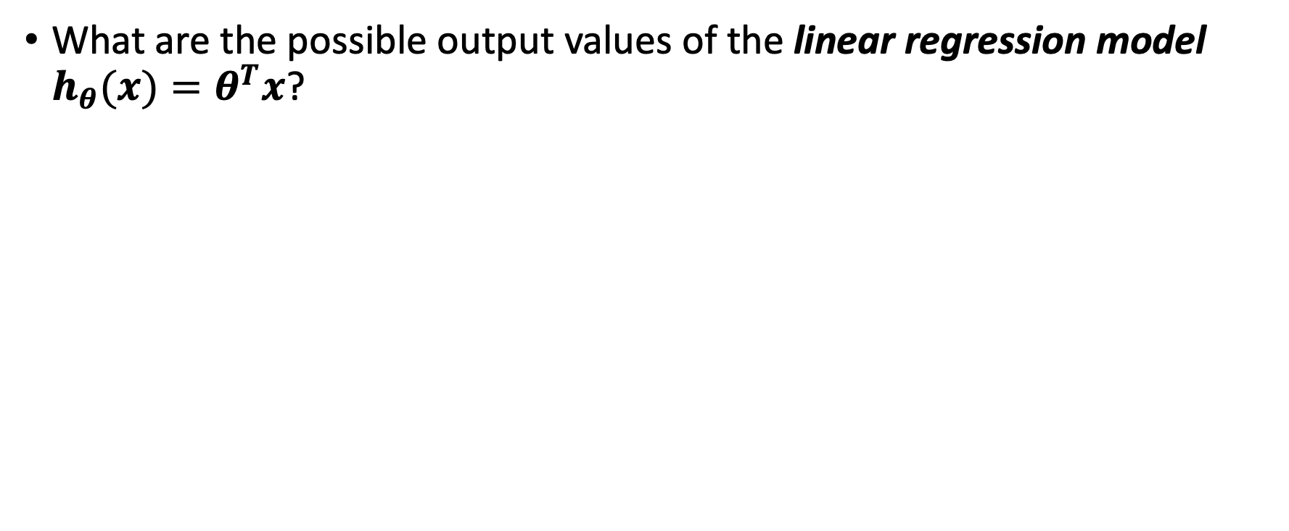
Regression vs. Classification
What are the possible output values of the linear regression model $h_{θ}(x)=θ^{T}x$?
$θ$ is the parameter vector, that is, $θ$ = [$θ0$, $θ1$, …, $θm$] (assuming $m + 1$parameters) and $x$ is the feature vector, that is, $x$ = [$x0$, $x1$, …, $xm$] (assuming $m + 1$ features and $x0=1$ to account for the intercept term, namely, $θ0$)

Slide 7
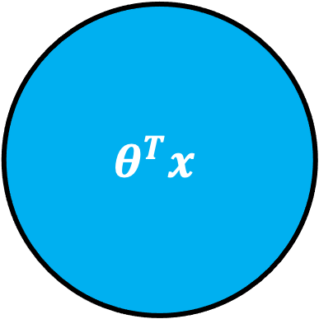
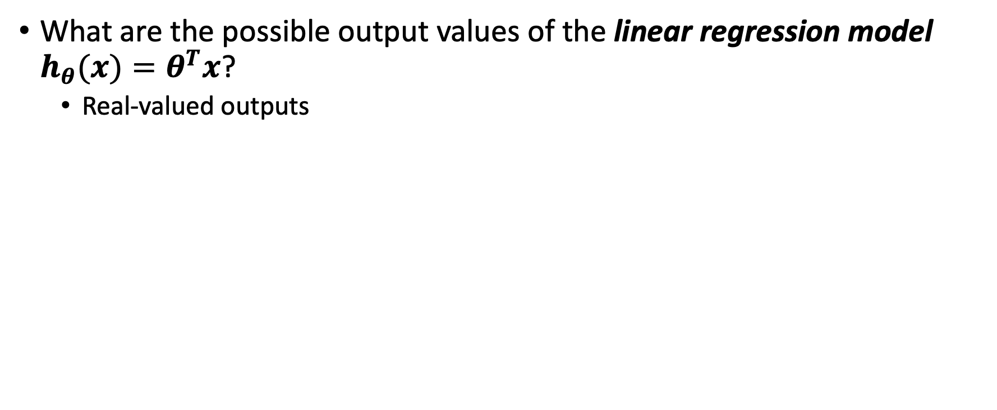

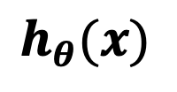
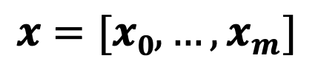
Regression vs. Classification
What are the possible output values of the linear regression model $h_{θ}(x)=θ^{T}x$?
Real-valued outputs
$$θ^{T}x$$
$$x=[x0,…,x_{m}]$$
$$h_{θ}(x)$$
$$∈ℝ$$

Slide 8

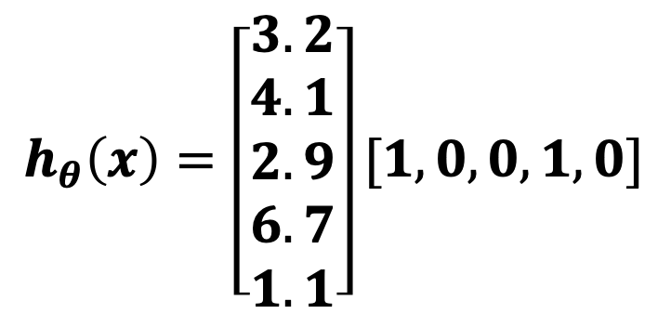
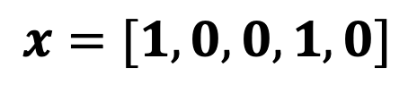
Regression vs. Classification
What are the possible output values of the linear regression model $h_{θ}(x)=θ^{T}x$?
Real-valued outputs
$$θ^{T}x$$
$$h_{θ}\left(x\right)=\left[\begin{aligned}3.2 \\ 4.1 \\ 2.9 \\ 6.7 \\ 1.1\end{aligned}\right][1,0, 0,1,0]$$
Spam Filter
$$x=[1,0, 0,1,0]$$
Representing an email
Assuming $\text{θ}\text{ = [}3.2, 4.1,2.9,6.7,1.1]$

Slide 9

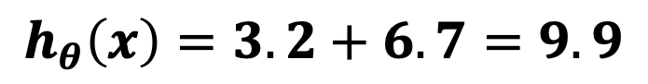
Regression vs. Classification
What are the possible output values of the linear regression model $h_{θ}(x)=θ^{T}x$?
Real-valued outputs
$∈ℝ$, which makes it a regression problem
$$θ^{T}x$$
Spam Filter
$$x=[1,0, 0,1,0]$$
$$h_{θ}\left(x\right)=3.2+6.7=9.9$$
A spam or not a spam?
We need a discrete-valued output (e.g., 1 or 0)

Slide 10

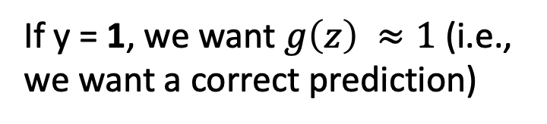
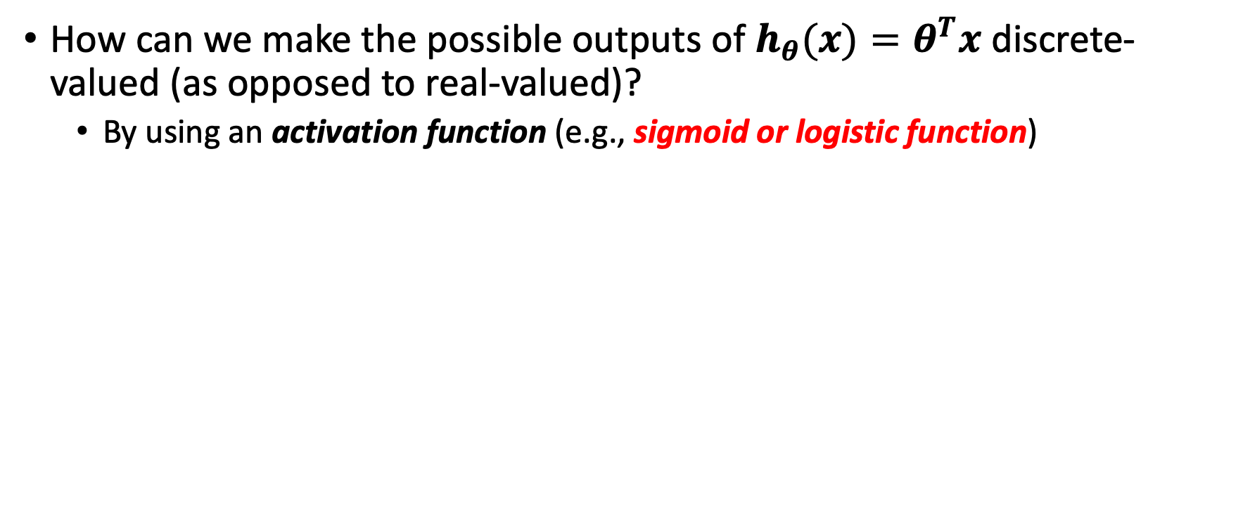

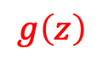
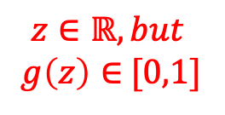
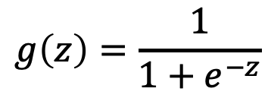

Regression vs. Classification
How can we make the possible outputs of $h_{θ}(x)=θ^{T}x$ discrete-valued (as opposed to real-valued)?
By using an activation function (e.g., sigmoid or logistic function)
$$g\left(z\right)$$
Assume a labeled example ($x$, y):
If y = 1, we want $g\left(z\right) ≈1$ (i.e., we want a correct prediction)
$$g\left(z\right)=\frac{1}{1+e^{−z}}$$
For this to happen, $z ≫0$
$$z∈ℝ, but$$ $g\left(z\right)∈$ [0,1]
$$z$$
0
8

Slide 11

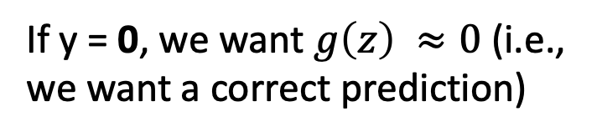
Regression vs. Classification
How can we make the possible outputs of $h_{θ}(x)=θ^{T}x$ discrete-valued (as opposed to real-valued)?
By using an activation function (e.g., sigmoid or logistic function)
$$g\left(z\right)$$
Assume a labeled example ($x$, y):
If y = 0, we want $g\left(z\right) ≈0$ (i.e., we want a correct prediction)
$$g\left(z\right)=\frac{1}{1+e^{−z}}$$
For this to happen, $z≪0$
$$z∈ℝ, but$$ $g\left(z\right)∈$ [0,1]
$$z$$
-8
0

Slide 12
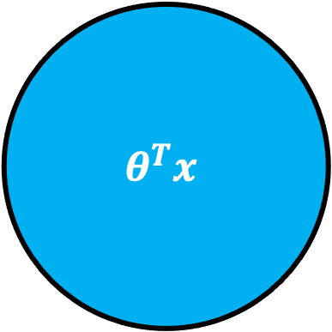
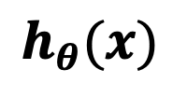
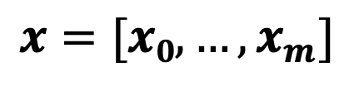
Regression vs. Classification
How can we make the possible outputs of $h_{θ}(x)=θ^{T}x$ discrete-valued (as opposed to real-valued)?
By using an activation function (e.g., sigmoid or logistic function)
$$θ^{T}x$$
$$x=[x0,…,x_{m}]$$
$$h_{θ}(x)$$
$$∈ℝ$$

Slide 13

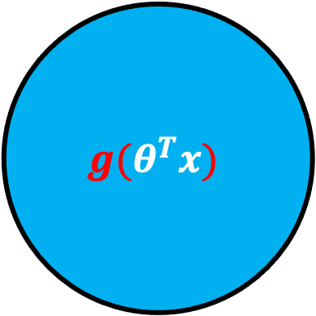

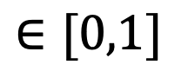
Regression vs. Classification
How can we make the possible outputs of $h_{θ}(x)=θ^{T}x$ discrete-valued (as opposed to real-valued)?
By using an activation function (e.g., sigmoid or logistic function)
$$g(θ^{T}x)$$
$$x=[x0,…,x_{m}]$$
$$h_{θ}(x)$$
$$∈[0,1]$$
We can now apply thresholding-- for example, if $h_{θ}(x)$ < 0.5, predict 0; otherwise, predict 1
$$z$$

Slide 14
Regression vs. Classification
How can we make the possible outputs of $h_{θ}(x)=θ^{T}x$ discrete-valued (as opposed to real-valued)?
By using an activation function (e.g., sigmoid or logistic function)
$$g(θ^{T}x)$$
$$x=[x0,…,x_{m}]$$
$$h_{θ}(x)$$
$$∈[0,1]$$
This makes it a classification problem (i.e., NOT a regression problem anymore) since the output renders a discrete one (especially after applying thresholding)
$$z$$

Slide 15
So, What is Logistic Regression?
Logistic regression is a machine learning algorithm that can be used to classify input data into discrete output (e.g., input emails into spam or non-spam and tumour images into benign or malignant)
Note: The word “regression” in the name does not mean that the algorithm is a regression algorithm (rather it is a classification algorithm)
Major questions about logistic regression:
What is the hypothesis function (or model)?
What is the cost function?
How can we learn the parameters of the model?

Slide 16
Outline
Logistic Regression
Classification
Hypothesis Function
Cost Function
Gradient Descent

Slide 17
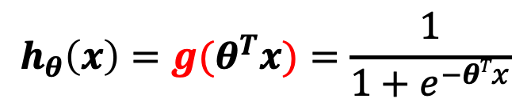
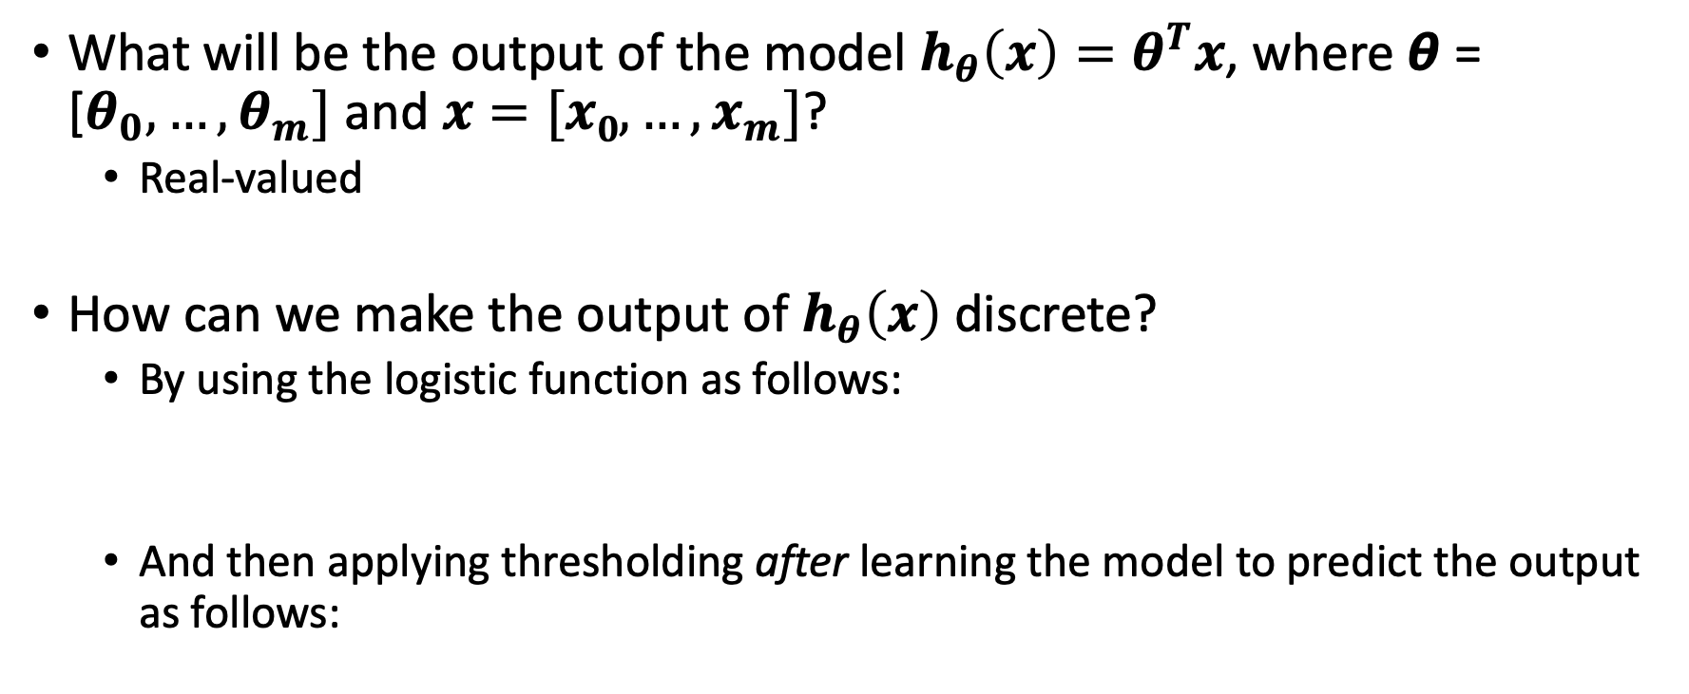
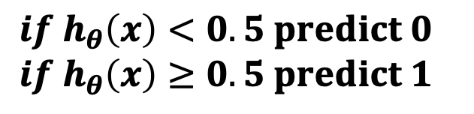
The Logistic Regression Model
What will be the output of the model $h_{θ}\left(x\right)=θ^{T}x$, where $\text{θ}\text{ = [}θ_{0}, …,θ_{m}]$ and $x=[x0,…,x_{m}]$?
Real-valued
How can we make the output of $h_{θ}\left(x\right)$discrete?
By using the logistic function as follows:
And then applying thresholding after learning the model to predict the output as follows:
$$h_{θ}\left(x\right)={g(θ}^{T}x)=\frac{1}{1+e^{−θTx}}$$
This is the logistic regression model or hypothesis function
$${if h}_{θ}\left(x\right)<0.5 predict 0$$
$${if h}_{θ}\left(x\right)≥0.5 predict 1$$

Slide 18
Outline
Logistic Regression
Classification
Hypothesis Function
Cost Function
Gradient Descent

Slide 19
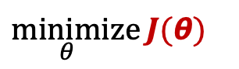
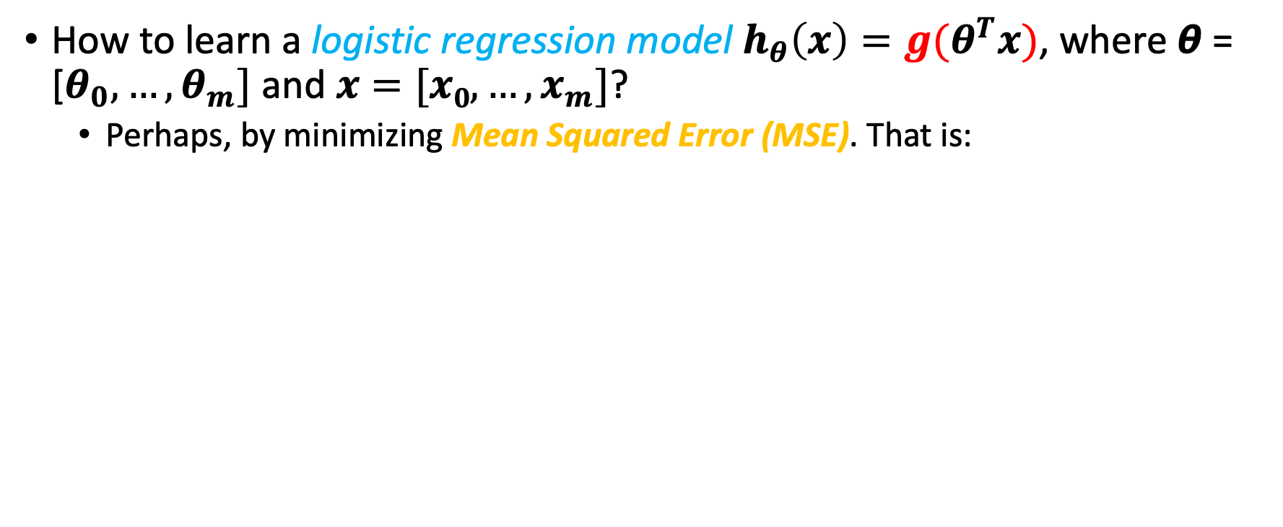

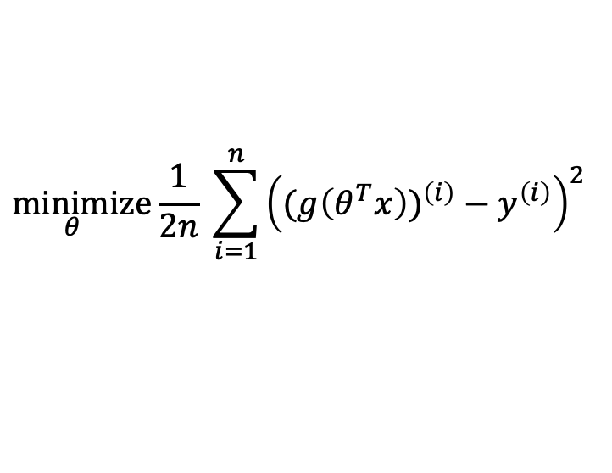
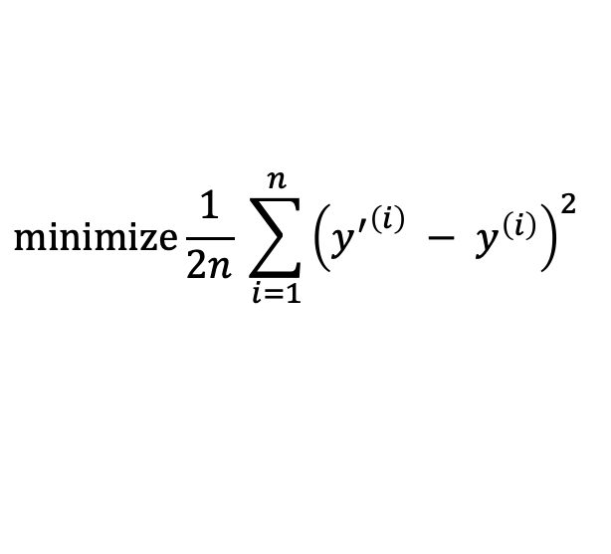
Towards Identifying the Logistic Regression Cost Function
How to learn a logistic regression model $h_{θ}\left(x\right)={g(θ}^{T}x)$, where $\text{θ}\text{ = [}θ_{0}, …,θ_{m}]$ and $x=[x0,…,x_{m}]$?
Perhaps, by minimizing Mean Squared Error (MSE). That is:
$$\underset{}{minimize}{\frac{1}{2n} \sum_{i=1}^{n}{{\left({y^{′}}^{\left(i\right)} − y^{\left(i\right)}\right)}^{2} }}$$
≣
Cost function
$J(\text{θ})$
$$\underset{θ_{}}{minimize}{\frac{1}{2n} \sum_{i=1}^{n}{{\left({(g\left(θ^{T}x\right))}^{\left(i\right)} − y^{\left(i\right)}\right)}^{2} }}$$
≣
$$\underset{θ_{}}{minimize}{J(\text{θ}) }$$

Slide 20

Towards Identifying the Logistic Regression Cost Function
How to learn a logistic regression model $h_{θ}\left(x\right)={g(θ}^{T}x)$, where $\text{θ}\text{ = [}θ_{0}, …,θ_{m}]$ and $x=[x0,…,x_{m}]$?
Perhaps, by minimizing Mean Squared Error (MSE). That is:
$$\underset{}{minimize}{\frac{1}{2n} \sum_{i=1}^{n}{{\left({y^{′}}^{\left(i\right)} − y^{\left(i\right)}\right)}^{2} }}$$
Convex
Unfortunately, if we plot this cost function, it will turn out to be “non-convex”
≣
Easy for
Gradient Descent
to locate!
$$\underset{θ_{}}{minimize}{\frac{1}{2n} \sum_{i=1}^{n}{{\left({(g\left(θ^{T}x\right))}^{\left(i\right)} − y^{\left(i\right)}\right)}^{2} }}$$
Global Min
≣
$$\underset{θ_{}}{minimize}{J(\text{θ}) }$$
$$\text{θ}$$

Slide 21
Towards Identifying the Logistic Regression Cost Function
How to learn a logistic regression model $h_{θ}\left(x\right)={g(θ}^{T}x)$, where $\text{θ}\text{ = [}θ_{0}, …,θ_{m}]$ and $x=[x0,…,x_{m}]$?
Perhaps, by minimizing Mean Squared Error (MSE). That is:
$$\underset{}{minimize}{\frac{1}{2n} \sum_{i=1}^{n}{{\left({y^{′}}^{\left(i\right)} − y^{\left(i\right)}\right)}^{2} }}$$
Gradient Descent
might get
stuck at a
local min
and fail to locate the global min!
Non-Convex
Local Min
Unfortunately, if we plot this cost function, it will turn out to be “non-convex”
≣
Global Min
$$\underset{θ_{}}{minimize}{\frac{1}{2n} \sum_{i=1}^{n}{{\left({(g\left(θ^{T}x\right))}^{\left(i\right)} − y^{\left(i\right)}\right)}^{2} }}$$
≣
$$\underset{θ_{}}{minimize}{J(\text{θ}) }$$
$$\text{θ}$$

Slide 22
Towards Identifying the Logistic Regression Cost Function
How to learn a logistic regression model $h_{θ}\left(x\right)={g(θ}^{T}x)$, where $\text{θ}\text{ = [}θ_{0}, …,θ_{m}]$ and $x=[x0,…,x_{m}]$?
Perhaps, by minimizing Mean Squared Error (MSE). That is:
$$\underset{}{minimize}{\frac{1}{2n} \sum_{i=1}^{n}{{\left({y^{′}}^{\left(i\right)} − y^{\left(i\right)}\right)}^{2} }}$$
We need a cost function that is convex, hence, being more suitable for Gradient Descent
Unfortunately, if we plot this cost function, it will turn out to be “non-convex”
≣
$$\underset{θ_{}}{minimize}{\frac{1}{2n} \sum_{i=1}^{n}{{\left({(g\left(θ^{T}x\right))}^{\left(i\right)} − y^{\left(i\right)}\right)}^{2} }}$$
≣
$$\underset{θ_{}}{minimize}{J(\text{θ}) }$$

Slide 23
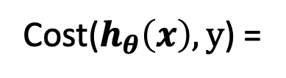
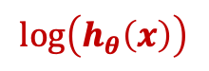
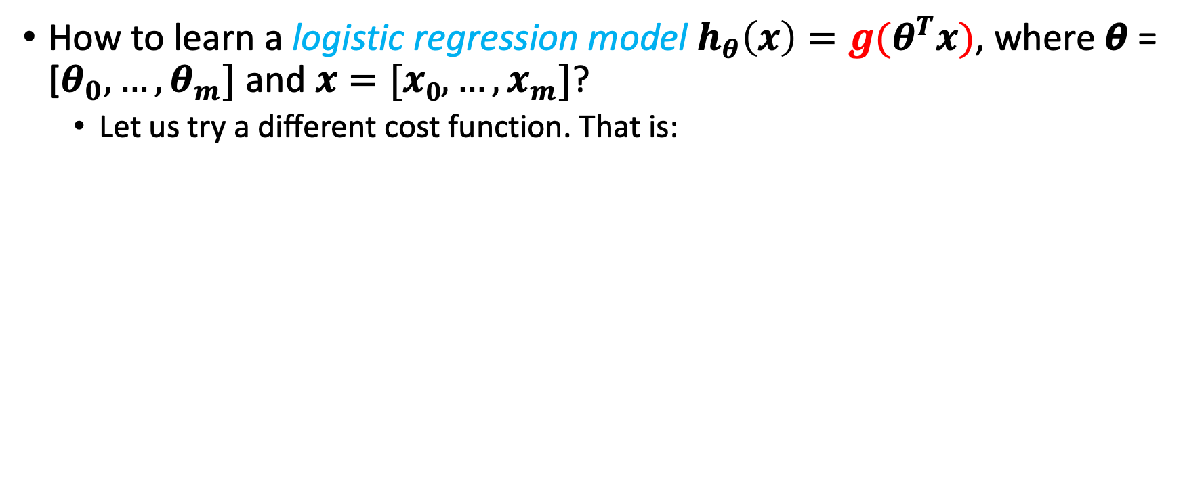
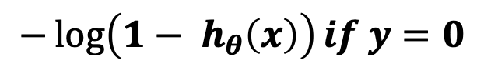
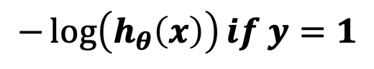
The Logistic Regression Cost Function
How to learn a logistic regression model $h_{θ}\left(x\right)={g(θ}^{T}x)$, where $\text{θ}\text{ = [}θ_{0}, …,θ_{m}]$ and $x=[x0,…,x_{m}]$?
Let us try a different cost function. That is:
$$−\log\left(h_{θ}\left(x\right)\right)if y=1$$
Cost($h_{θ}\left(x\right), y$) =
$$\log\left(h_{θ}\left(x\right)\right)$$
$$−\log\left({1− h}_{θ}\left(x\right)\right)if y=0$$

Slide 24
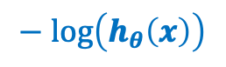
The Logistic Regression Cost Function
How to learn a logistic regression model $h_{θ}\left(x\right)={g(θ}^{T}x)$, where $\text{θ}\text{ = [}θ_{0}, …,θ_{m}]$ and $x=[x0,…,x_{m}]$?
Let us try a different cost function. That is:
$$−\log\left(h_{θ}\left(x\right)\right)if y=1$$
Cost($h_{θ}\left(x\right), y$) =
$$\log\left(h_{θ}\left(x\right)\right)$$
$$−\log\left({1− h}_{θ}\left(x\right)\right)if y=0$$
$$− log\left(h_{θ}\left(x\right)\right)$$

Slide 25
The Logistic Regression Cost Function
How to learn a logistic regression model $h_{θ}\left(x\right)={g(θ}^{T}x)$, where $\text{θ}\text{ = [}θ_{0}, …,θ_{m}]$ and $x=[x0,…,x_{m}]$?
Let us try a different cost function. That is:
$$−\log\left(h_{θ}\left(x\right)\right)if y=1$$
Zoom In
Cost($h_{θ}\left(x\right), y$) =
$$−\log\left({1− h}_{θ}\left(x\right)\right)if y=0$$
1
$$− log\left(h_{θ}\left(x\right)\right)$$

Slide 26
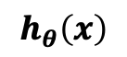
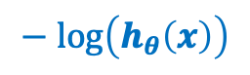
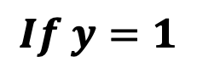

The Logistic Regression Cost Function
How to learn a logistic regression model $h_{θ}\left(x\right)={g(θ}^{T}x)$, where $\text{θ}\text{ = [}θ_{0}, …,θ_{m}]$ and $x=[x0,…,x_{m}]$?
Let us try a different cost function. That is:
$$−\log\left(h_{θ}\left(x\right)\right)if y=1$$
Cost($h_{θ}\left(x\right), y$) =
$$−\log\left({1− h}_{θ}\left(x\right)\right)if y=0$$
$$− log\left(h_{θ}\left(x\right)\right)$$
0
$$h_{θ}\left(x\right)$$
As $h_{θ}\left(x\right)$ ➔ 0, $−\log\left(h_{θ}\left(x\right)\right)$ ➔ $∞$
$$If y=1$$
As $h_{θ}\left(x\right)$ ➔ 1, $−\log\left(h_{θ}\left(x\right)\right)$ ➔ $0$ (i.e., cost ➔ 0)

Slide 27
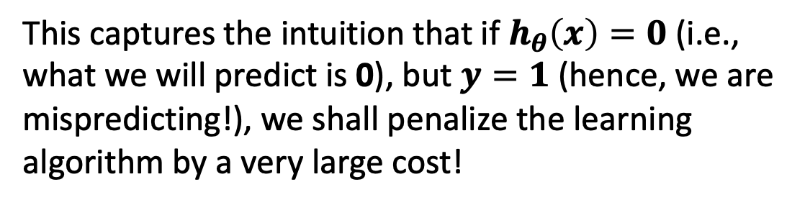
The Logistic Regression Cost Function
How to learn a logistic regression model $h_{θ}\left(x\right)={g(θ}^{T}x)$, where $\text{θ}\text{ = [}θ_{0}, …,θ_{m}]$ and $x=[x0,…,x_{m}]$?
Let us try a different cost function. That is:
$$−\log\left(h_{θ}\left(x\right)\right)if y=1$$
Cost($h_{θ}\left(x\right), y$) =
$$−\log\left({1− h}_{θ}\left(x\right)\right)if y=0$$
$$− log\left(h_{θ}\left(x\right)\right)$$
0
This captures the intuition that if $h_{θ}\left(x\right)=0$ (i.e., what we will predict is 0), but $y=1$ (hence, we are mispredicting!), we shall penalize the learning algorithm by a very large cost!
$$h_{θ}\left(x\right)$$

Slide 28
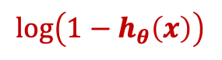
The Logistic Regression Cost Function
How to learn a logistic regression model $h_{θ}\left(x\right)={g(θ}^{T}x)$, where $\text{θ}\text{ = [}θ_{0}, …,θ_{m}]$ and $x=[x0,…,x_{m}]$?
Let us try a different cost function. That is:
$$−\log\left(h_{θ}\left(x\right)\right)if y=1$$
Cost($h_{θ}\left(x\right), y$) =
$$\log\left(1−h_{θ}\left(x\right)\right)$$
$$−\log\left({1− h}_{θ}\left(x\right)\right)if y=0$$

Slide 29
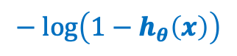
The Logistic Regression Cost Function
How to learn a logistic regression model $h_{θ}\left(x\right)={g(θ}^{T}x)$, where $\text{θ}\text{ = [}θ_{0}, …,θ_{m}]$ and $x=[x0,…,x_{m}]$?
Let us try a different cost function. That is:
$$−\log\left(h_{θ}\left(x\right)\right)if y=1$$
Zoom In
Cost($h_{θ}\left(x\right), y$) =
$$−\log\left({1− h}_{θ}\left(x\right)\right)if y=0$$
1
$$− log\left(1−h_{θ}\left(x\right)\right)$$

Slide 30
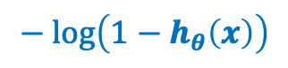
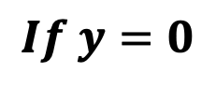

The Logistic Regression Cost Function
How to learn a logistic regression model $h_{θ}\left(x\right)={g(θ}^{T}x)$, where $\text{θ}\text{ = [}θ_{0}, …,θ_{m}]$ and $x=[x0,…,x_{m}]$?
Let us try a different cost function. That is:
$$−\log\left(h_{θ}\left(x\right)\right)if y=1$$
Cost($h_{θ}\left(x\right), y$) =
$$− log\left(1−h_{θ}\left(x\right)\right)$$
$$−\log\left({1− h}_{θ}\left(x\right)\right)if y=0$$
$$h_{θ}\left(x\right)$$
As $h_{θ}\left(x\right)$ ➔ 0, $−\log\left(h_{θ}\left(x\right)\right)$ ➔ $0$
$$If y=0$$
As $h_{θ}\left(x\right)$ ➔ 1, $−\log\left(h_{θ}\left(x\right)\right)$ ➔$∞$ (i.e., cost ➔$∞$)

Slide 31
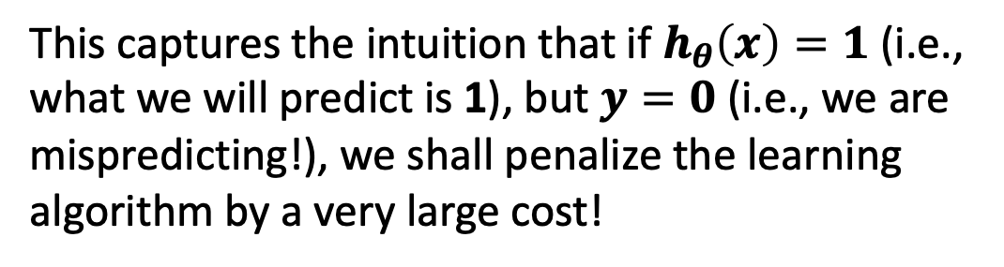
The Logistic Regression Cost Function
How to learn a logistic regression model $h_{θ}\left(x\right)={g(θ}^{T}x)$, where $\text{θ}\text{ = [}θ_{0}, …,θ_{m}]$ and $x=[x0,…,x_{m}]$?
Let us try a different cost function. That is:
$$−\log\left(h_{θ}\left(x\right)\right)if y=1$$
Cost($h_{θ}\left(x\right), y$) =
$$− log\left(1−h_{θ}\left(x\right)\right)$$
$$−\log\left({1− h}_{θ}\left(x\right)\right)if y=0$$
This captures the intuition that if $h_{θ}\left(x\right)=1$ (i.e., what we will predict is 1), but $y=0$ (i.e., we are mispredicting!), we shall penalize the learning algorithm by a very large cost!
$$h_{θ}\left(x\right)$$

Slide 32
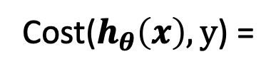
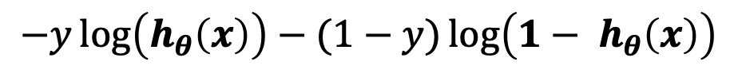
The Logistic Regression Cost Function
How to learn a logistic regression model $h_{θ}\left(x\right)={g(θ}^{T}x)$, where $\text{θ}\text{ = [}θ_{0}, …,θ_{m}]$ and $x=[x0,…,x_{m}]$?
Let us try a different cost function. That is:
$$−\log\left(h_{θ}\left(x\right)\right)if y=1$$
Cost($h_{θ}\left(x\right), y$) =
$$−\log\left({1− h}_{θ}\left(x\right)\right)if y=0$$
Equivalent To
Cost($h_{θ}\left(x\right), y$) =
$$−y\log\left(h_{θ}\left(x\right)\right)−(1−y)\log\left({1− h}_{θ}\left(x\right)\right)$$

Slide 33
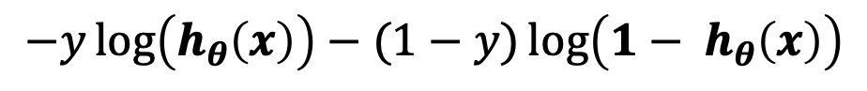
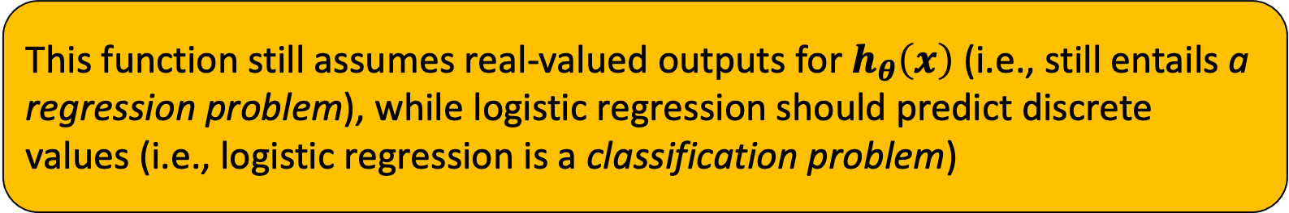
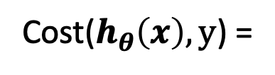
The Logistic Regression Cost Function
How to learn a logistic regression model $h_{θ}\left(x\right)={g(θ}^{T}x)$, where $\text{θ}\text{ = [}θ_{0}, …,θ_{m}]$ and $x=[x0,…,x_{m}]$?
Let us try a different cost function. That is:
Cost($h_{θ}\left(x\right), y$) =
$$−y\log\left(h_{θ}\left(x\right)\right)−(1−y)\log\left({1− h}_{θ}\left(x\right)\right)$$
This function still assumes real-valued outputs for $h_{θ}\left(x\right)$(i.e., still entails a regression problem), while logistic regression should predict discrete values (i.e., logistic regression is a classification problem)

Slide 34
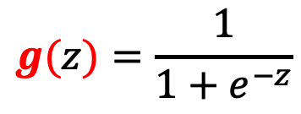
The Logistic Regression Cost Function
How to learn a logistic regression model $h_{θ}\left(x\right)={g(θ}^{T}x)$, where $\text{θ}\text{ = [}θ_{0}, …,θ_{m}]$ and $x=[x0,…,x_{m}]$?
Let us try a different cost function. That is:
Cost($h_{θ}\left(x\right), y$) =
$$−y\log\left(h_{θ}\left(x\right)\right)−(1−y)\log\left({1− h}_{θ}\left(x\right)\right)$$
We still need to apply to it the logistic function:
$$g(z)=\frac{1}{1+e^{−z}}$$

Slide 35

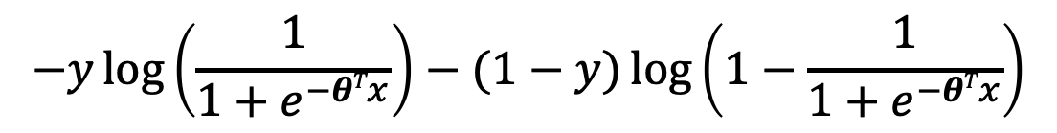


The Logistic Regression Cost Function
How to learn a logistic regression model $h_{θ}\left(x\right)={g(θ}^{T}x)$, where $\text{θ}\text{ = [}θ_{0}, …,θ_{m}]$ and $x=[x0,…,x_{m}]$?
By minimizing the following cost function:
Cost($h_{θ}\left(x\right), y$) =
$$−y\log\left(h_{θ}\left(x\right)\right)−(1−y)\log\left({1− h}_{θ}\left(x\right)\right)$$
Cost($h_{θ}\left(x\right), y$) =
$$−y\log\left({g(θ}^{T}x)\right)−(1−y)\log\left(1−{g(θ}^{T}x)\right)$$
$$−y\log\left(\frac{1}{1+e^{−θTx}}\right)−(1−y)\log\left(1−\frac{1}{1+e^{−θTx}}\right)$$
Cost($h_{θ}\left(x\right), y$) =

Slide 36







The Logistic Regression Cost Function
How to learn a logistic regression model $h_{θ}\left(x\right)={g(θ}^{T}x)$, where $\text{θ}\text{ = [}θ_{0}, …,θ_{m}]$ and $x=[x0,…,x_{m}]$?
By minimizing the following cost function:
$$−y\log\left(\frac{1}{1+e^{−θTx}}\right)−(1−y)\log\left(1−\frac{1}{1+e^{−θTx}}\right)$$
Cost($h_{θ}\left(x\right), y$) =
I$f y=1$, we want $θ^{T}x$ >> 0
I$f y=0$, we want $θ^{T}x$ << 0
$$−log\left(\frac{1}{1+e^{−θTx}}\right)$$
$$−log\left(1−\frac{1}{1+e^{−θTx}}\right)$$
$$θ^{T}x$$
$$θ^{T}x$$

Slide 37
Next Monday’s Lecture…
Logistic Regression- Part II

